Slide 1
Approximate ANN on road networks
Saranya Sadasivam

Slide 2
Topics
Introduction
Motivation
Problem definition
Solution
Algorithm design
Experimental results
Progress till now

Slide 3
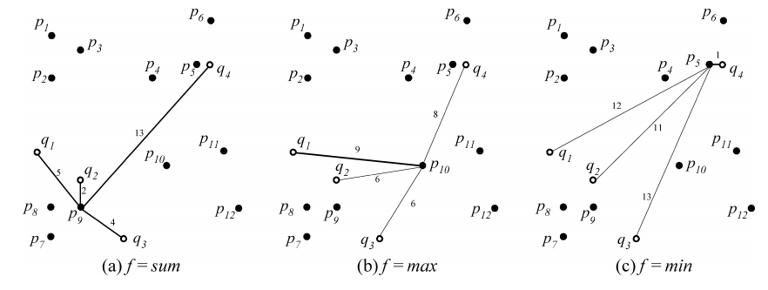
Introduction
Aggregate nearest neighbor (ANN) queries
Image from “Aggregate Nearest Neighbor Queries in Spatial Databases” Dimitris Papadias et al

Slide 4
Introduction (contd.)
Applications of ANN queries
Place to meet the earliest
Place to build a factory so that raw materials are at least possible net distance
Materials which are most similar to another material
And many more..

Slide 5
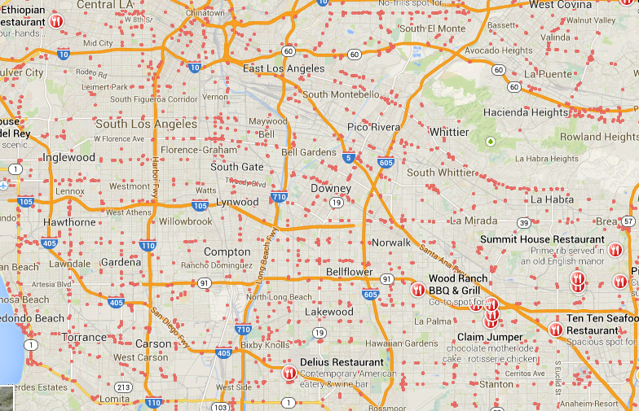
Motivation
Euclidean distance
Easier to implement
Easier to understand
Road network applications need network distance

Slide 6
Motivation (contd.)
Existing pre-computation techniques, large storage over head
Others require expensive processing at query time
Find a technique that
Is faster in query time processing
Requires lesser pre-computed data

Slide 7
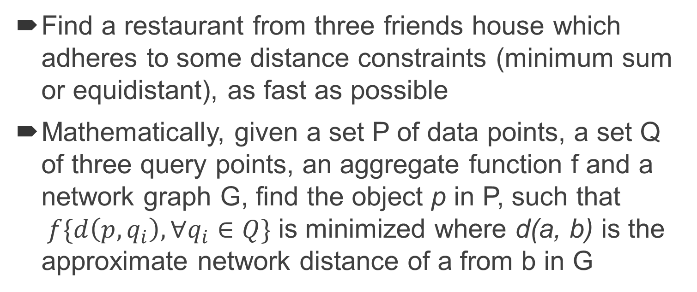
Problem definition
Find a restaurant from three friends house which adheres to some distance constraints (minimum sum or equidistant), as fast as possible
Mathematically, given a set P of data points, a set Q of three query points, an aggregate function f and a network graph G, find the object p in P, such that $f\{d\left(p,q_{i}\right), ∀q_{i}∈Q\}$ is minimized where d(a, b) is the approximate network distance of a from b in G

Slide 8
Solution
Fasten processing time
Use simple geometric properties
Use pre-computation based on grids
Lower pre-computation storage
Use approximation to store only a fixed amount of reference points per grid

Slide 9
Solution (contd.)
G3
G4
G5
Grid points (GP)
rp1
Reference points (RP)
rp2
Data points (DP)
gp1
gp2
r1
Grid cell G1
G6
Set of GP
Set of RP
Set of DP
Set of GP – RP pairs
Set of RP – RP shortest
network distance
Present flag
G2
G1
rp3
rp4
gp4
gp3
G9
G8
G7
Use pre-computation based on grids
Use approximation to store only a fixed amount of reference points per grid

Slide 10
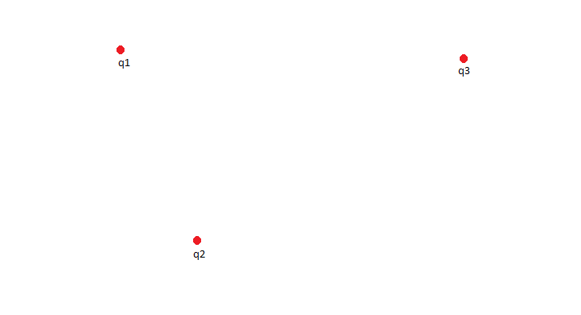
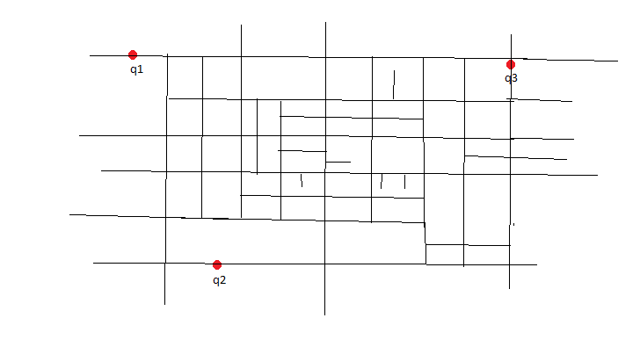
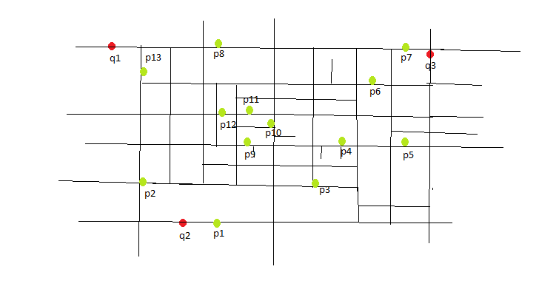
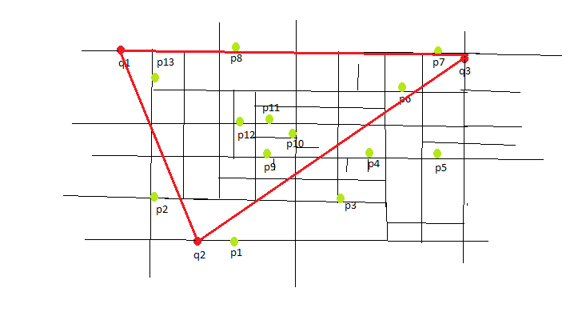
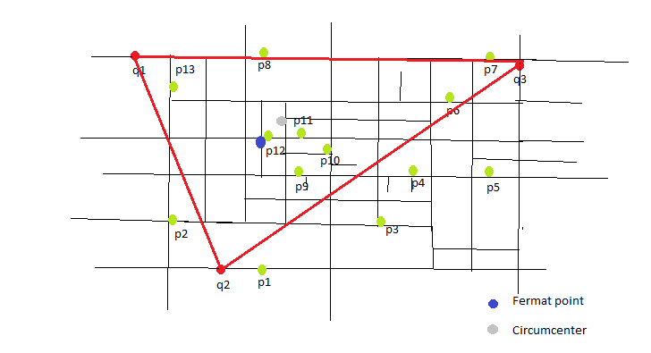
Solution (contd.)
Use simple geometric properties

Slide 11
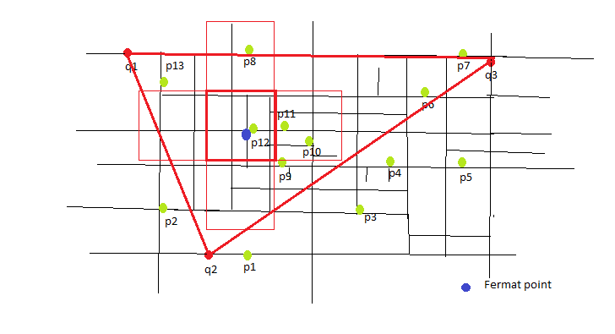
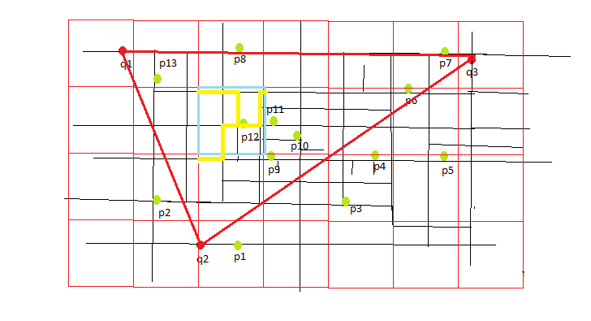
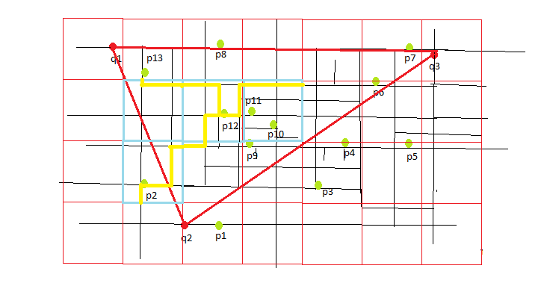
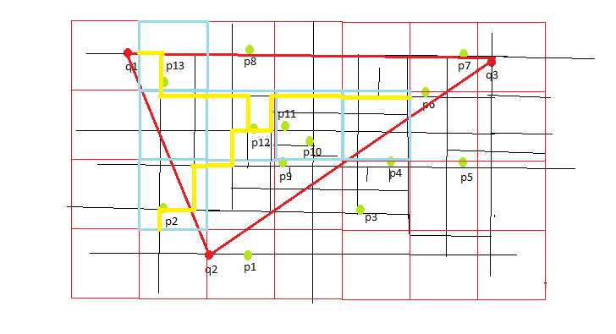
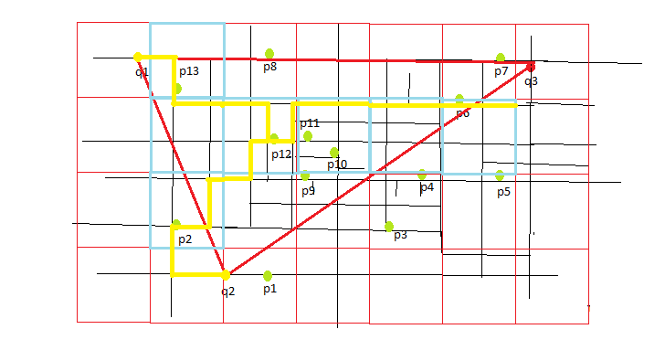
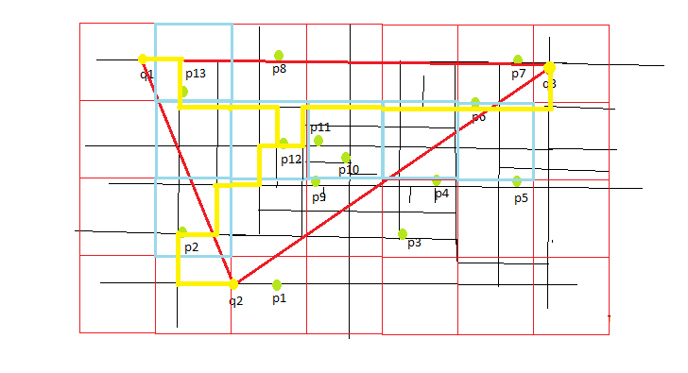
Solution (contd.)

Slide 12
Solution (contd.)
Fermat point
Data point

Slide 13
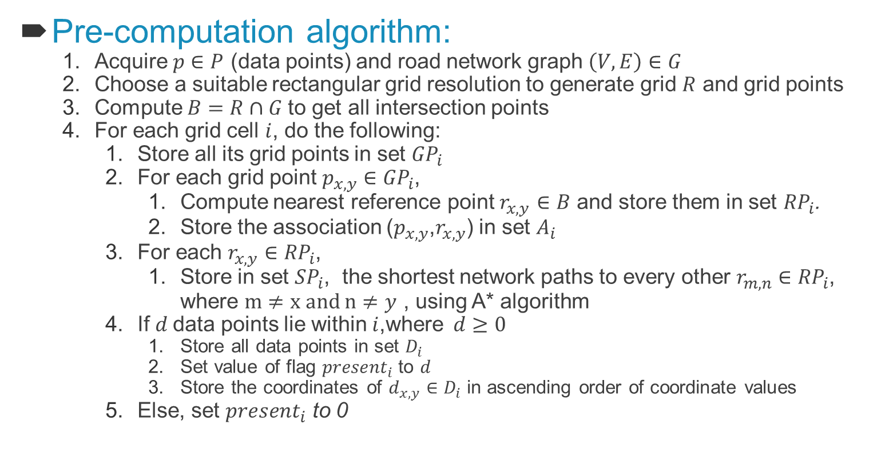
Algorithm description
Pre-computation algorithm:
Acquire $p∈P$ (data points) and road network graph $\left(V,E\right)∈G$
Choose a suitable rectangular grid resolution to generate grid $R$ and grid points
Compute $B=R∩G$to get all intersection points
For each grid cell $i$, do the following:
Store all its grid points in set ${GP}_{i}$
For each grid point $p_{x,y}∈$ ${GP}_{i}$,
Compute nearest reference point $r_{x,y}$ $∈B$ and store them in set ${RP}_{i}$.
Store the association ($p_{x,y}$,$r_{x,y}$) in set $A_{i}$
For each $r_{x,y}∈{RP}_{i}$,
Store in set ${SP}_{i}$, the shortest network paths to every other $r_{m,n}∈{RP}_{i}$, where $m≠x and n≠y$ , using A* algorithm
If $d$data points lie within $i$,where$d≥0$
Store all data points in set $D_{i}$
Set value of flag ${present}_{i}$to $d$
Store the coordinates of $d_{x,y}∈D_{i}$ in ascending order of coordinate values
Else, set ${present}_{i}$ to 0

Slide 14
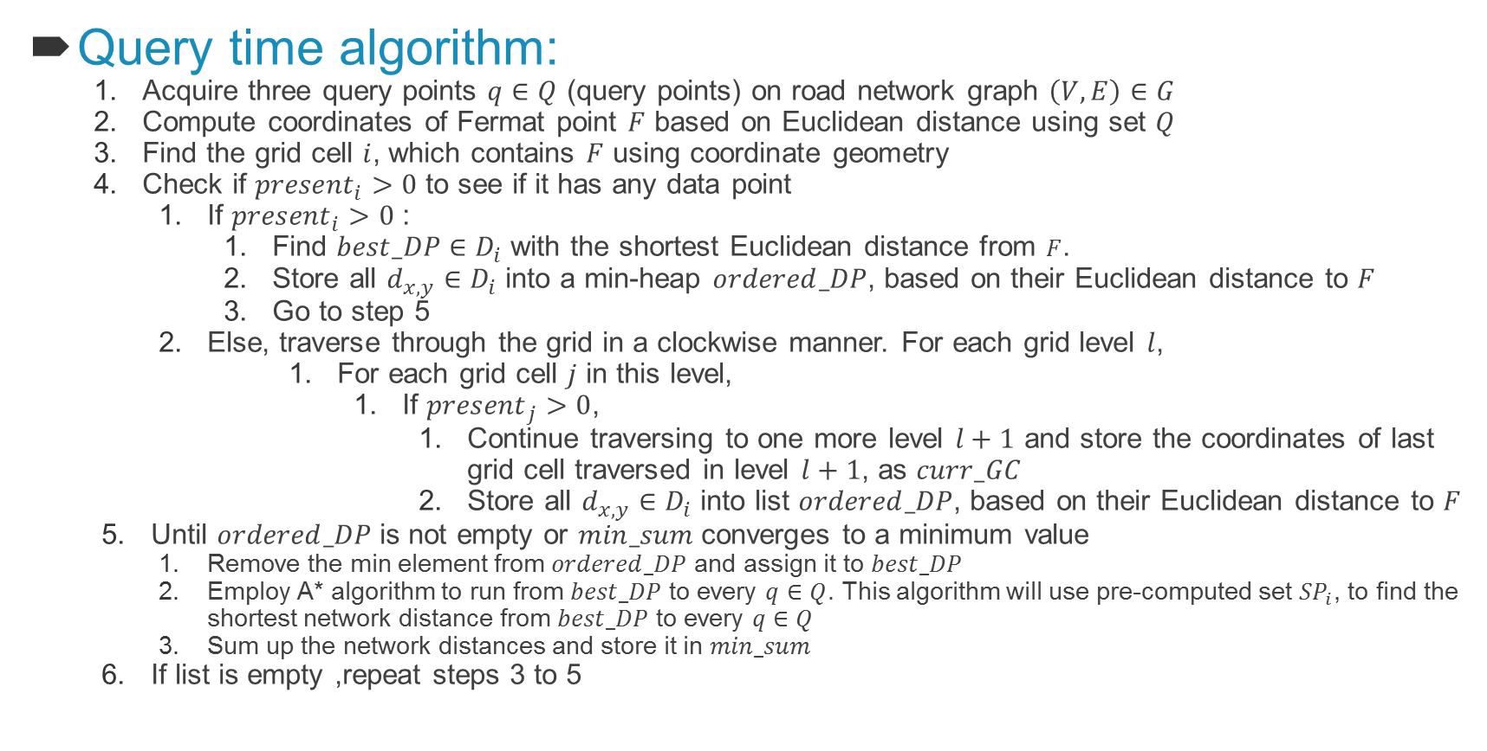
Algorithm description
Query time algorithm:
Acquire three query points $q∈Q$ (query points) on road network graph $\left(V,E\right)∈G$
Compute coordinates of Fermat point $F$ based on Euclidean distance using set $Q$
Find the grid cell $i$, which contains $F$ using coordinate geometry
Check if ${present}_{i}>0$ to see if it has any data point
If ${present}_{i}>0$ :
Find $best_DP∈D_{i}$ with the shortest Euclidean distance from $F$.
Store all $d_{x,y}∈D_{i}$ into a min-heap $ordered_DP$, based on their Euclidean distance to $F$
Go to step 5
Else, traverse through the grid in a clockwise manner. For each grid level $l$,
For each grid cell $j$ in this level,
If ${present}_{j}>0$,
Continue traversing to one more level $l+1$ and store the coordinates of last grid cell traversed in level $l+1$, as $curr_GC$
Store all $d_{x,y}∈D_{i}$ into list $ordered_DP$, based on their Euclidean distance to $F$
Until $ordered_DP$ is not empty or $min_sum$ converges to a minimum value
Remove the min element from $ordered_DP$ and assign it to $best_DP$
Employ A* algorithm to run from $best_DP$ to every $q∈Q$. This algorithm will use pre-computed set ${SP}_{i}$, to find the shortest network distance from $best_DP$ to every $q∈Q$
Sum up the network distances and store it in $min_sum$
If list is empty ,repeat steps 3 to 5

Slide 15
Experimental setup
PC Configuration
Intel® Core™ 2 Duo CPU at 2.2GHz
4.00 GB RAM
Windows 7 32-bit OS
Implemented in Java
Datasets
Dataset type | No. of nodes | No. of edges | No. of data points
California road network | 21048 | 21693 | 7680
City of San Joaquin County road network | 18262 | 23873 | Randomly generated
City of Oldenburg road network | 6104 | 7034 | Randomly generated

Slide 16
Experimental analysis
Observation: Shortest path retrieval algorithm dominates the query processing time
Experimented with several grid sizes
Randomly generated 1000 sets of three query points
Captured performance of AANN and ANN on these query sets
Used metrics to plot results

Slide 17
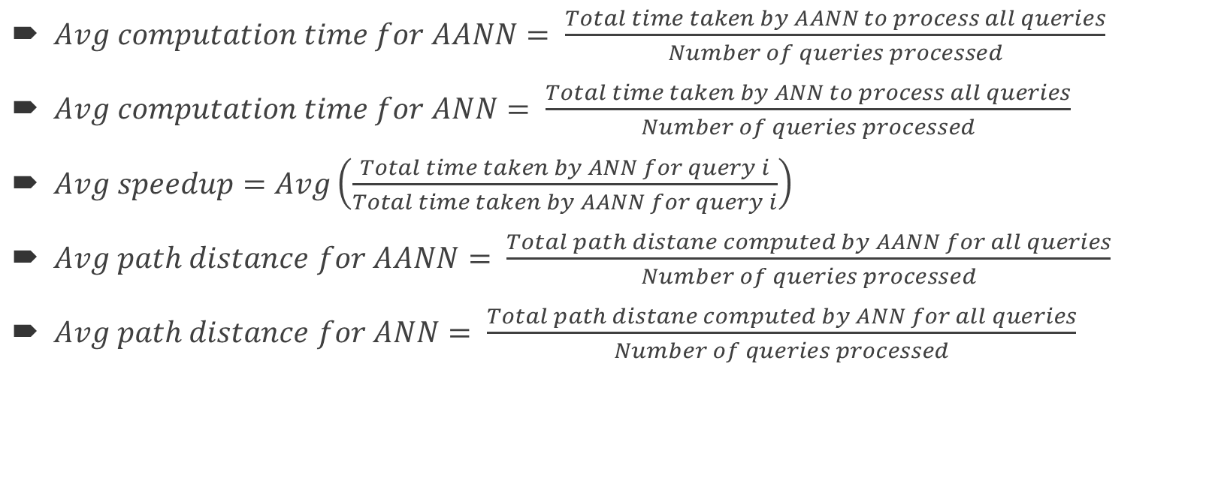
Experiment metrics
$Avg computation time for AANN= \frac{Total time taken by AANN to process all queries}{Number of queries processed}$
$Avg computation time for ANN= \frac{Total time taken by ANN to process all queries}{Number of queries processed}$
$Avg speedup=Avg\left(\frac{Total time taken by ANN for query i}{Total time taken by AANN for query i}\right)$
$Avg path distance for AANN= \frac{Total path distane computed by AANN for all queries}{Number of queries processed}$
$Avg path distance for ANN= \frac{Total path distane computed by ANN for all queries}{Number of queries processed}$

Slide 18
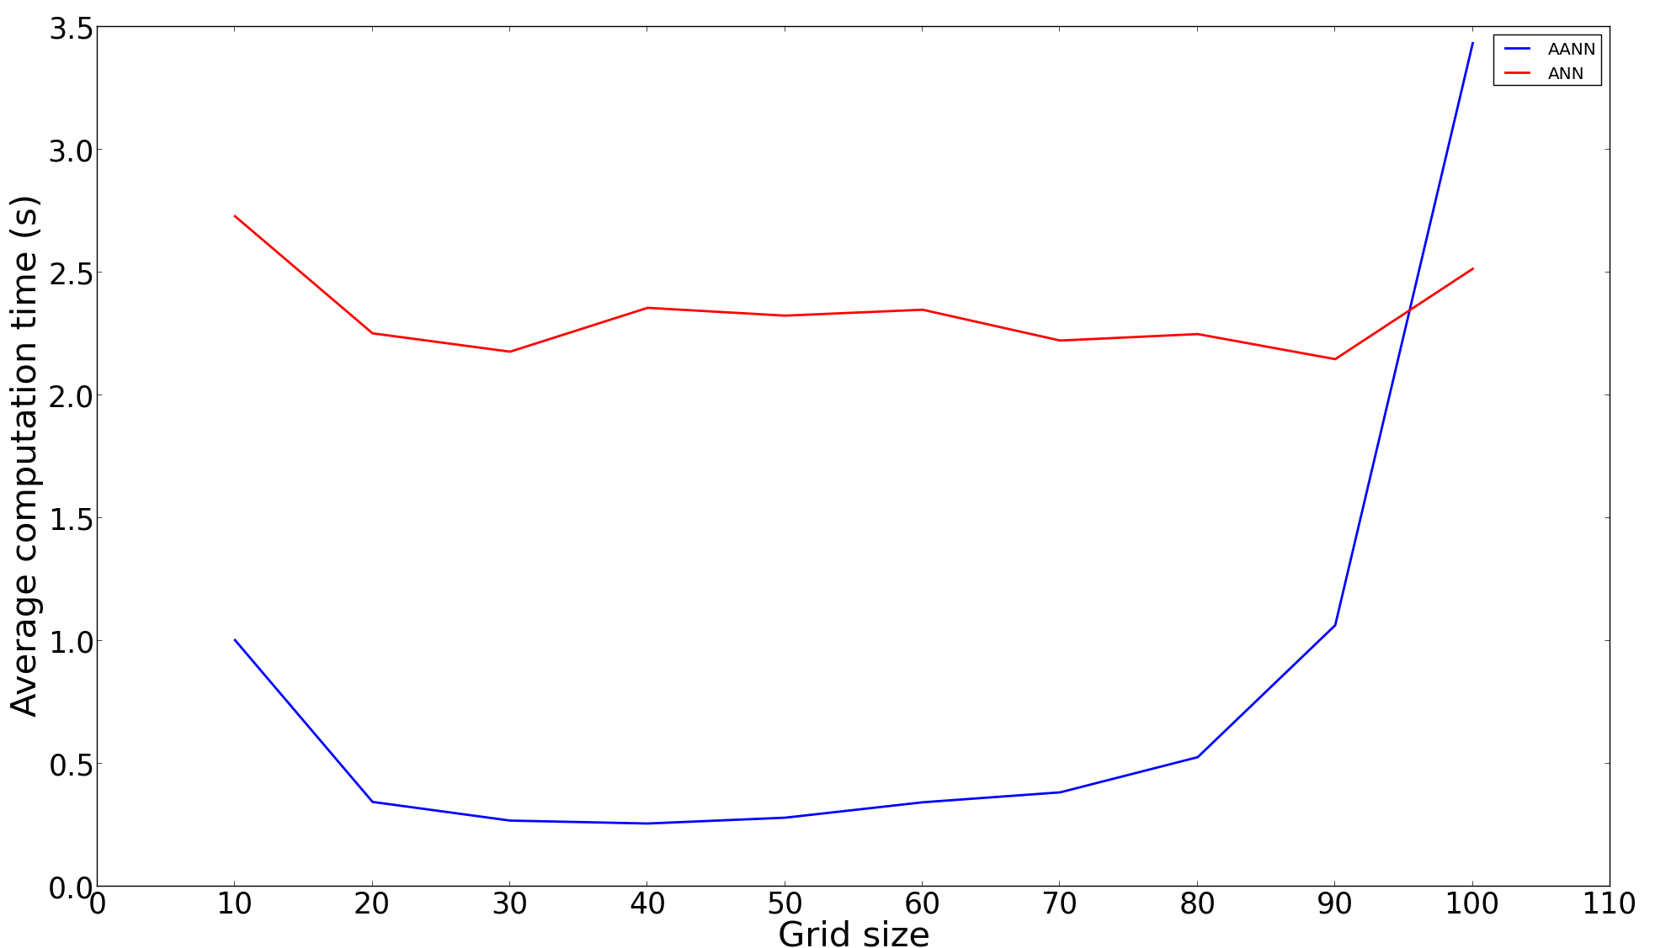
Experimental results: Avg computation time
Network has 21048 nodes and there are 10000 grid cells. Grid greater than 70X70 have too small cells to capture pre-computed data
With fewer grid cells more network points have to be traversed to shortest path from one reference points to other
AANN is five times faster than ANN for specific grid sizes
Only certain grid sizes give optimal results

Slide 19
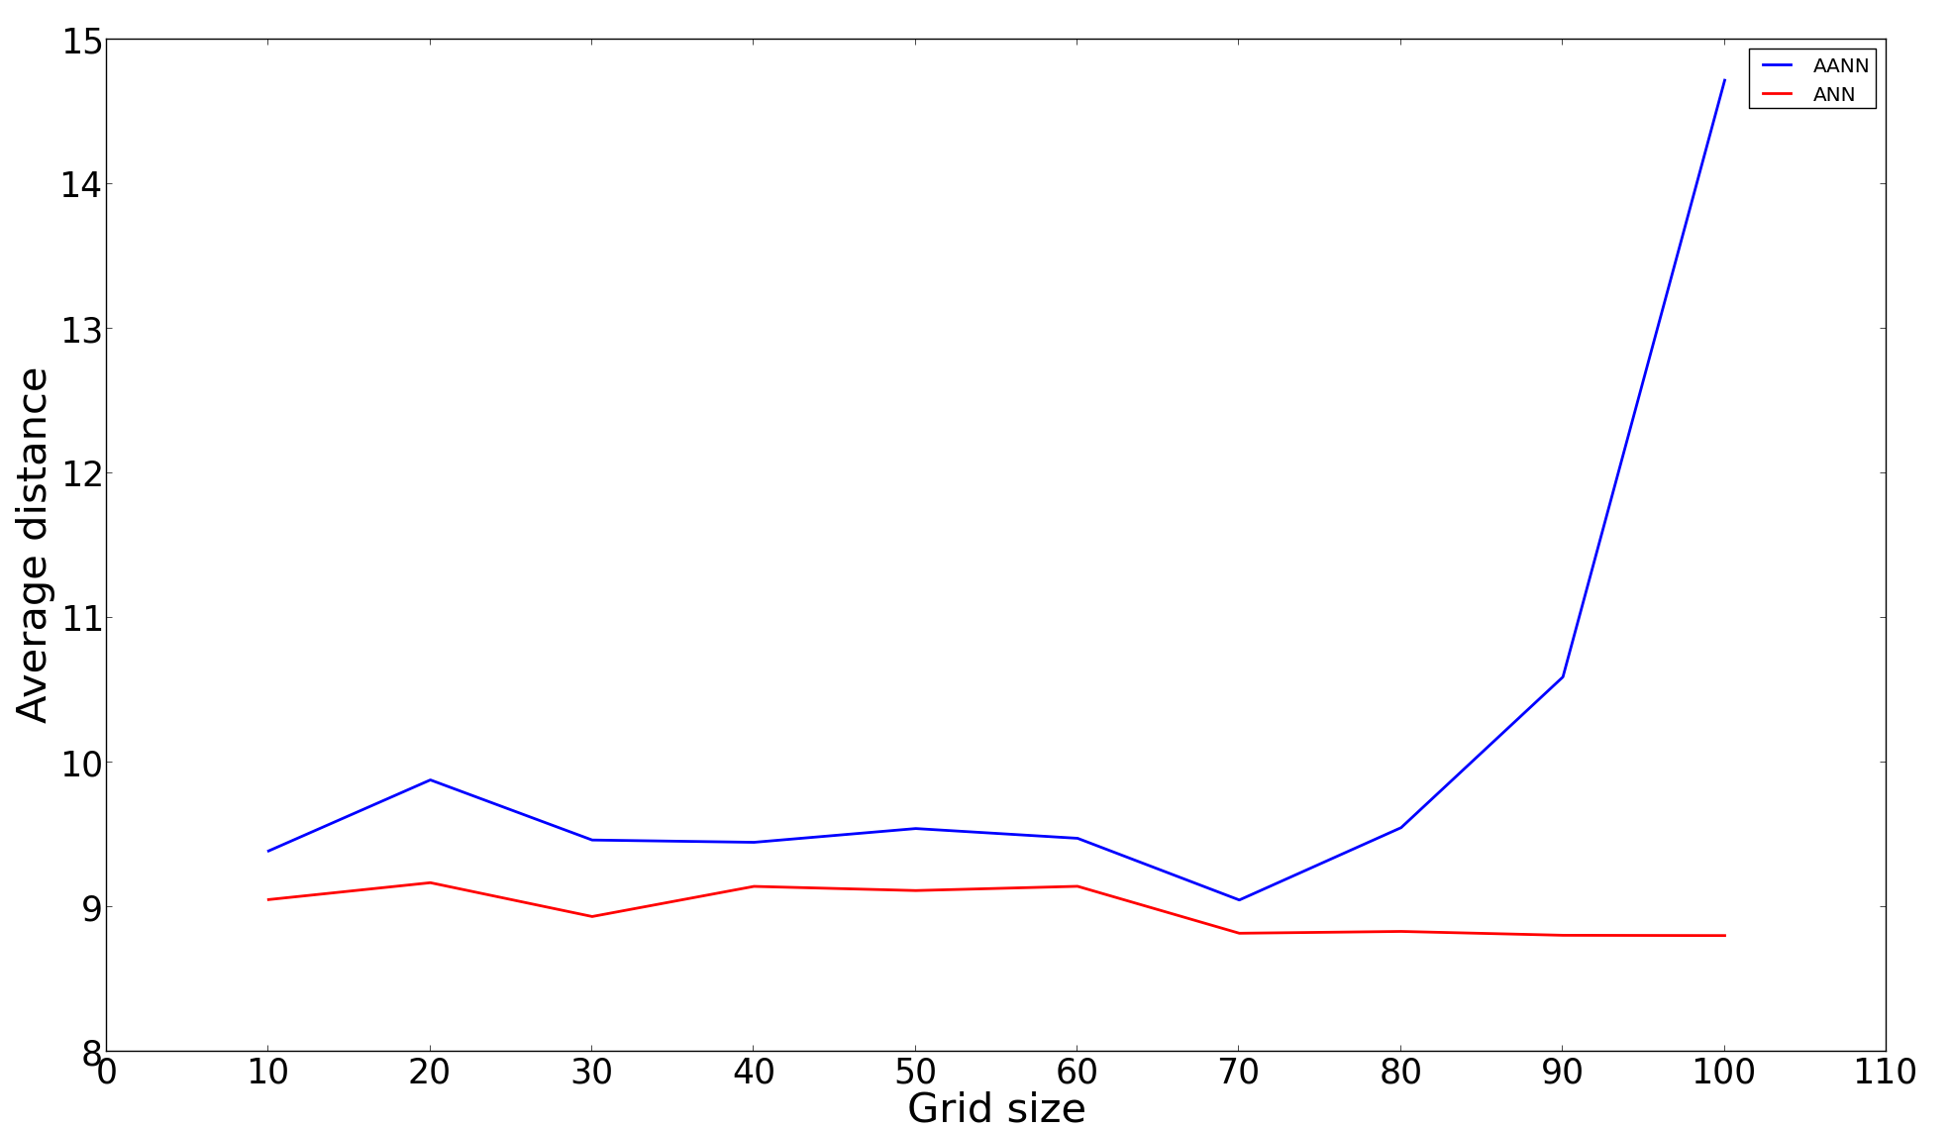
Experimental results: Avg path distance
Grid greater than 70X70 have too small cells to capture pre-computed data
Average path distance of AANN differs only by a constant for a good range of grid cell sizes
Average path distance is computed by ANN and AANN differs by a constant

Slide 20
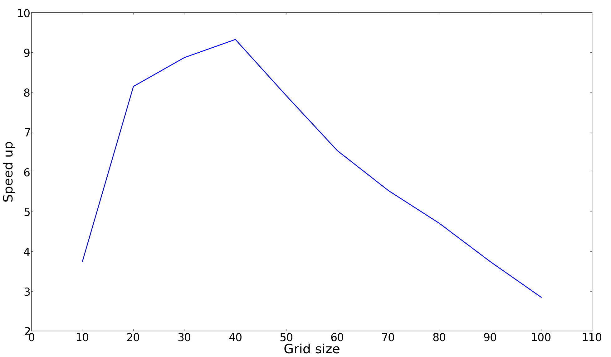
Experimental results: Speed up
A 40X40 grid speeds up computation by 9 times
AANN speeds up the computation to a good extent as compared to ANN

Slide 21
Progress till now
Till now
Algorithm design and optimization
AANN implementation
ANN implementation
Experimental result collection (ANN vs AANN)
Experimental analysis
Currently and future work
Algorithm implementation to show that shortest path computation dominates other time costs
Testing on different datasets
Analyzing test results and writing paper

Slide 22
Thank you

